Slide 1


Breaking Down Breakdowns & delays in SMRT
Presented by: Wen Qiyuan
Last Updated: 3rd April 2023

Slide 2

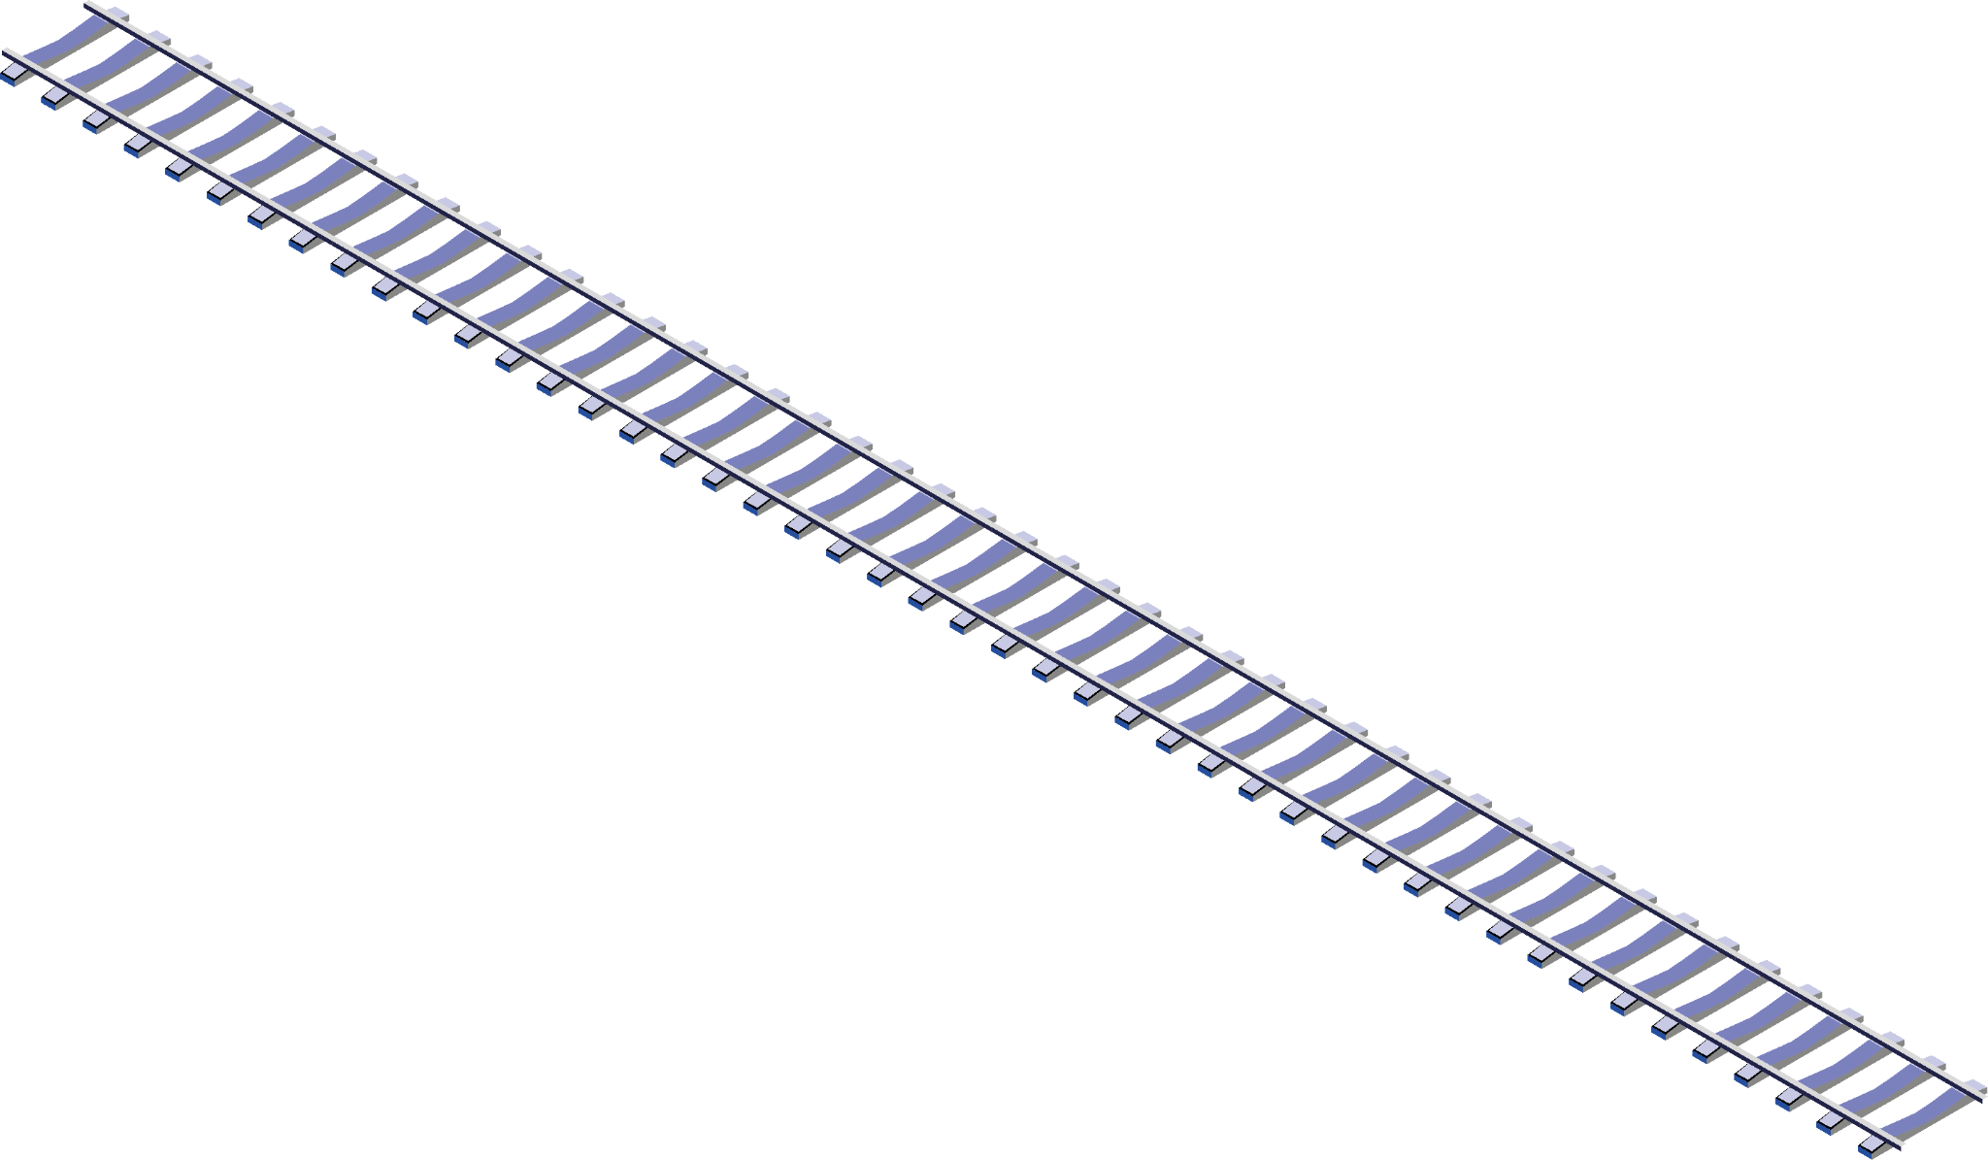
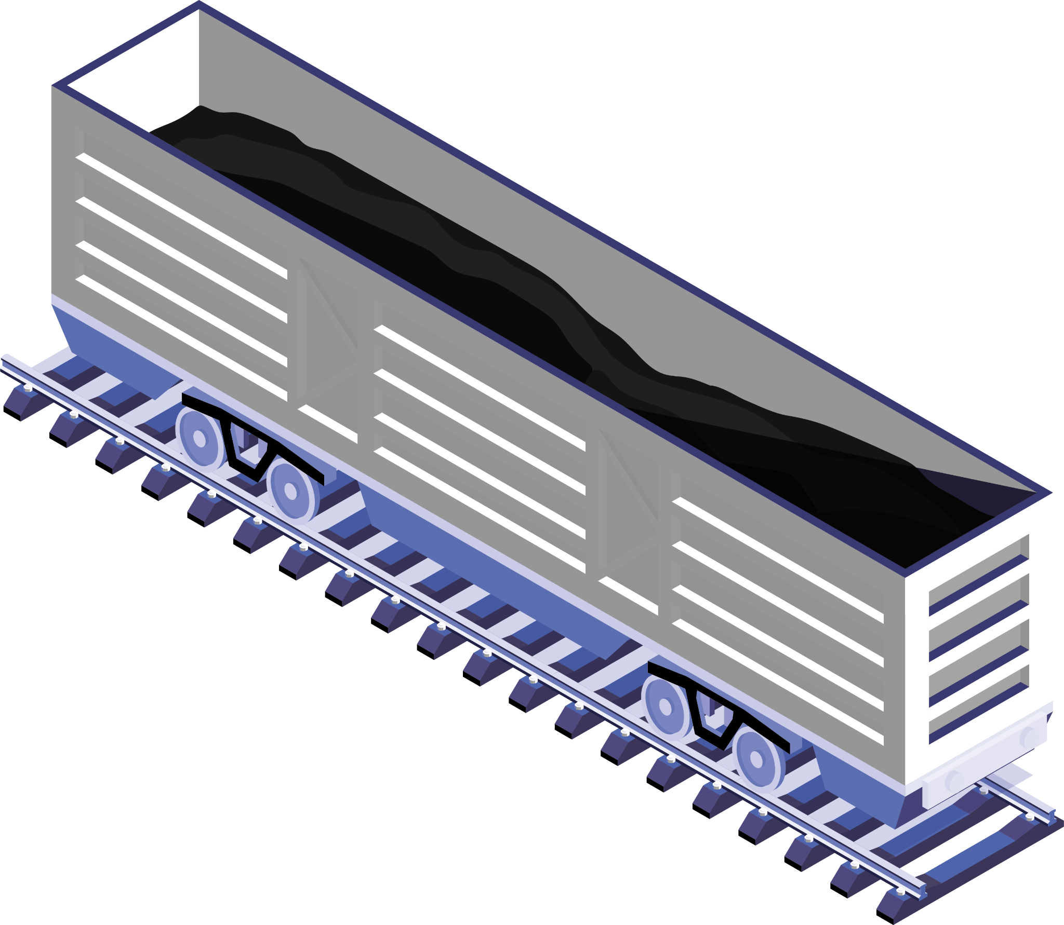
Railway of contents
1
Datasets
Problem
2
3
EDA/Demo
Modeling
4
5
Conclusion
Notes:
Problem and individual motivation
EDA – insights in tableau
Modeling
Demo

Slide 3
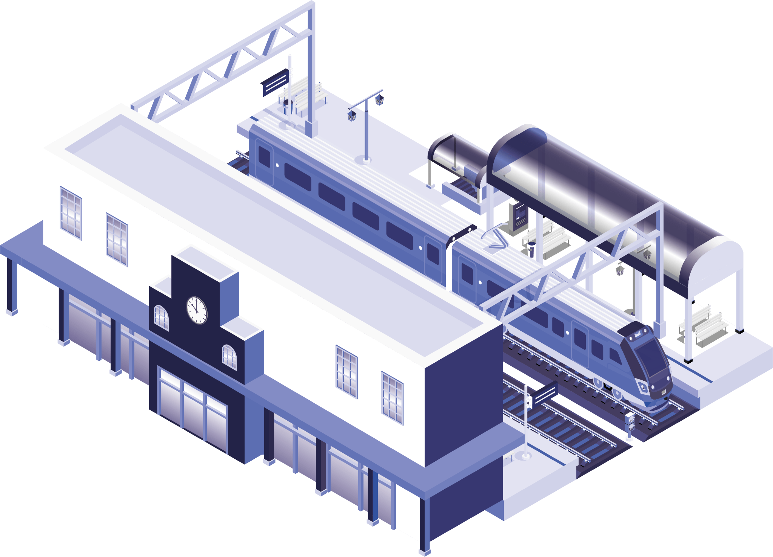
01
INTRO

Slide 4
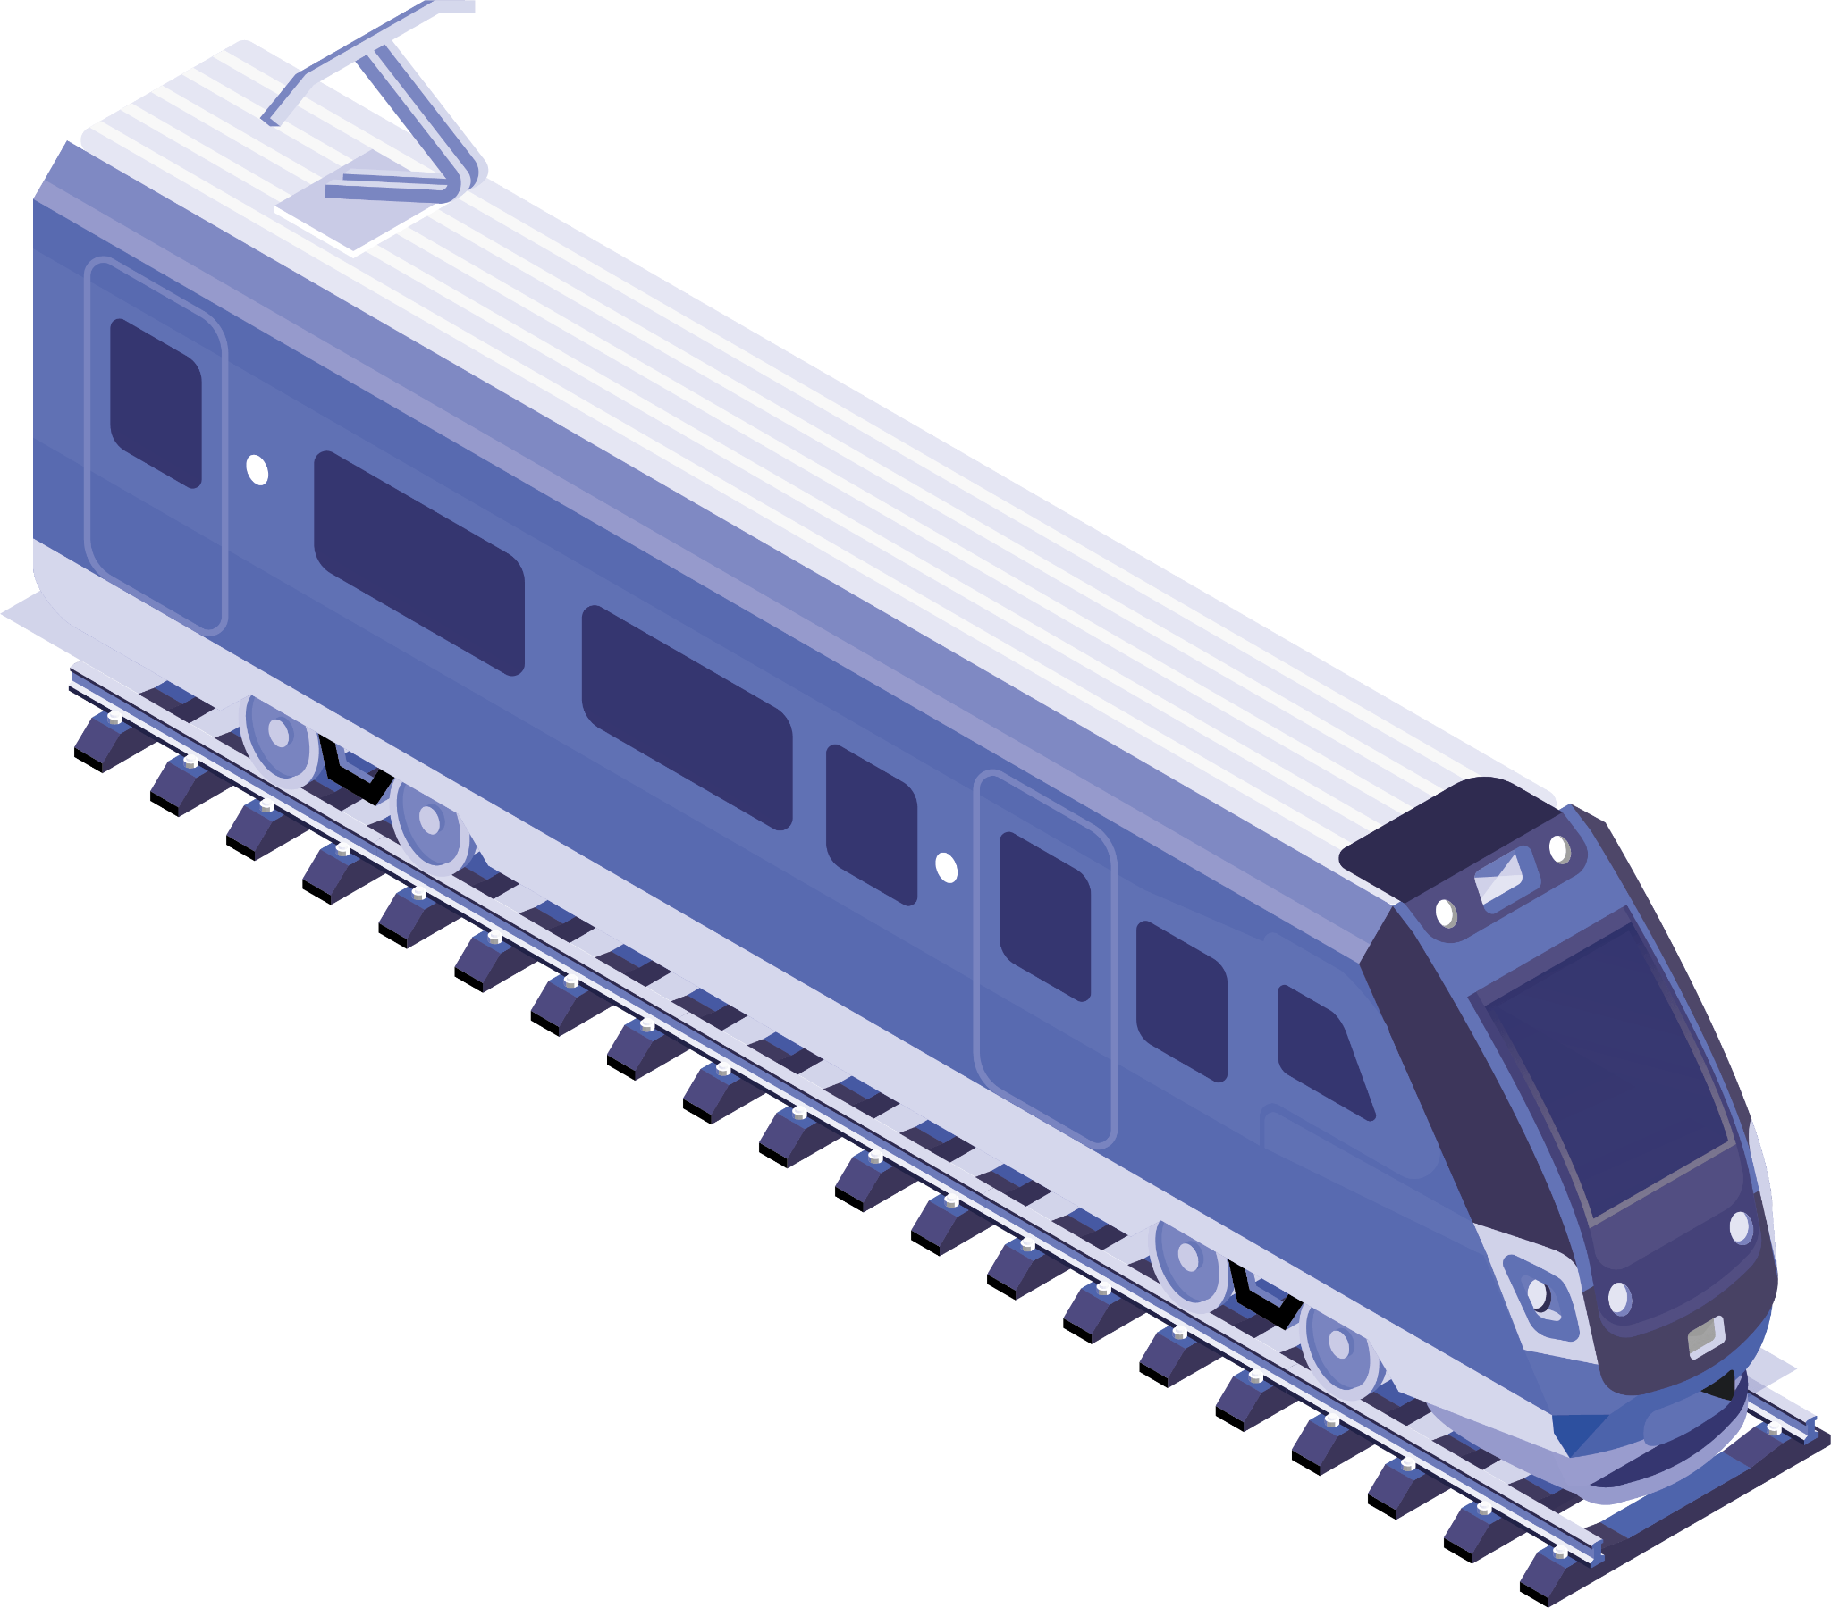

Problem statement
SMRT Train breakdowns/delays/faults still causing frustration and inconvenience for commuters.
Notes:
Despite ongoing efforts to improve the MRT system in Singapore in the past half decade, train delays and faults remain a

Slide 5
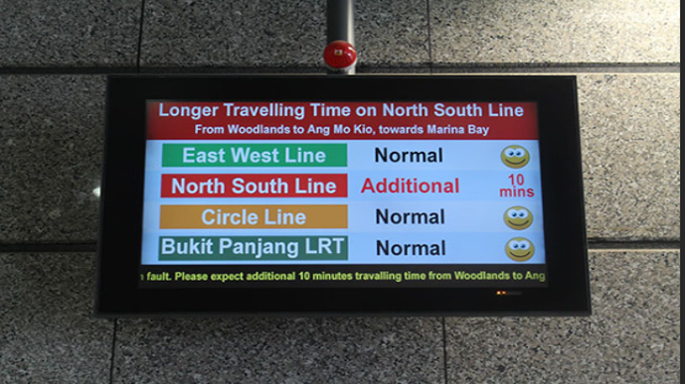


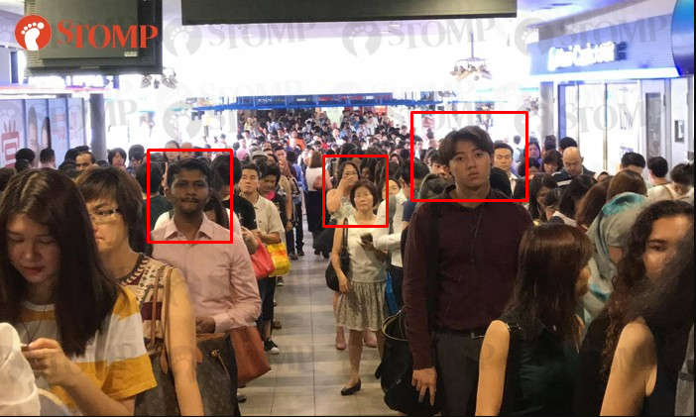

A picture is worth a thousand words

Slide 6

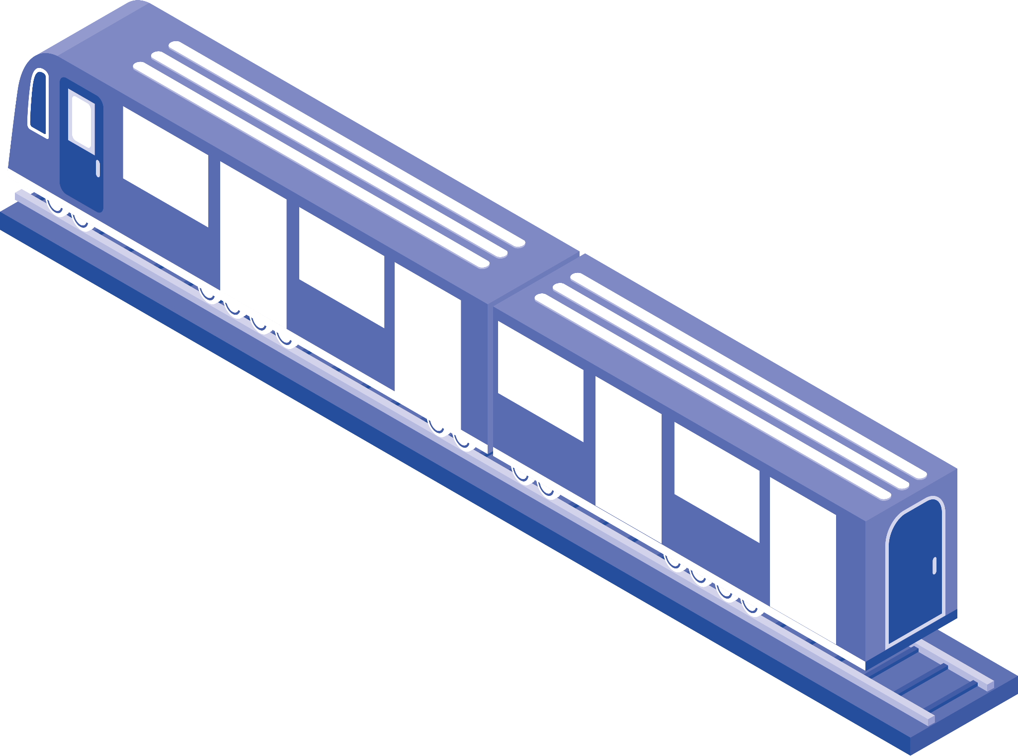
Objectives
Build Train Delays Predictor to help commuters better plan their travel options.

Slide 7
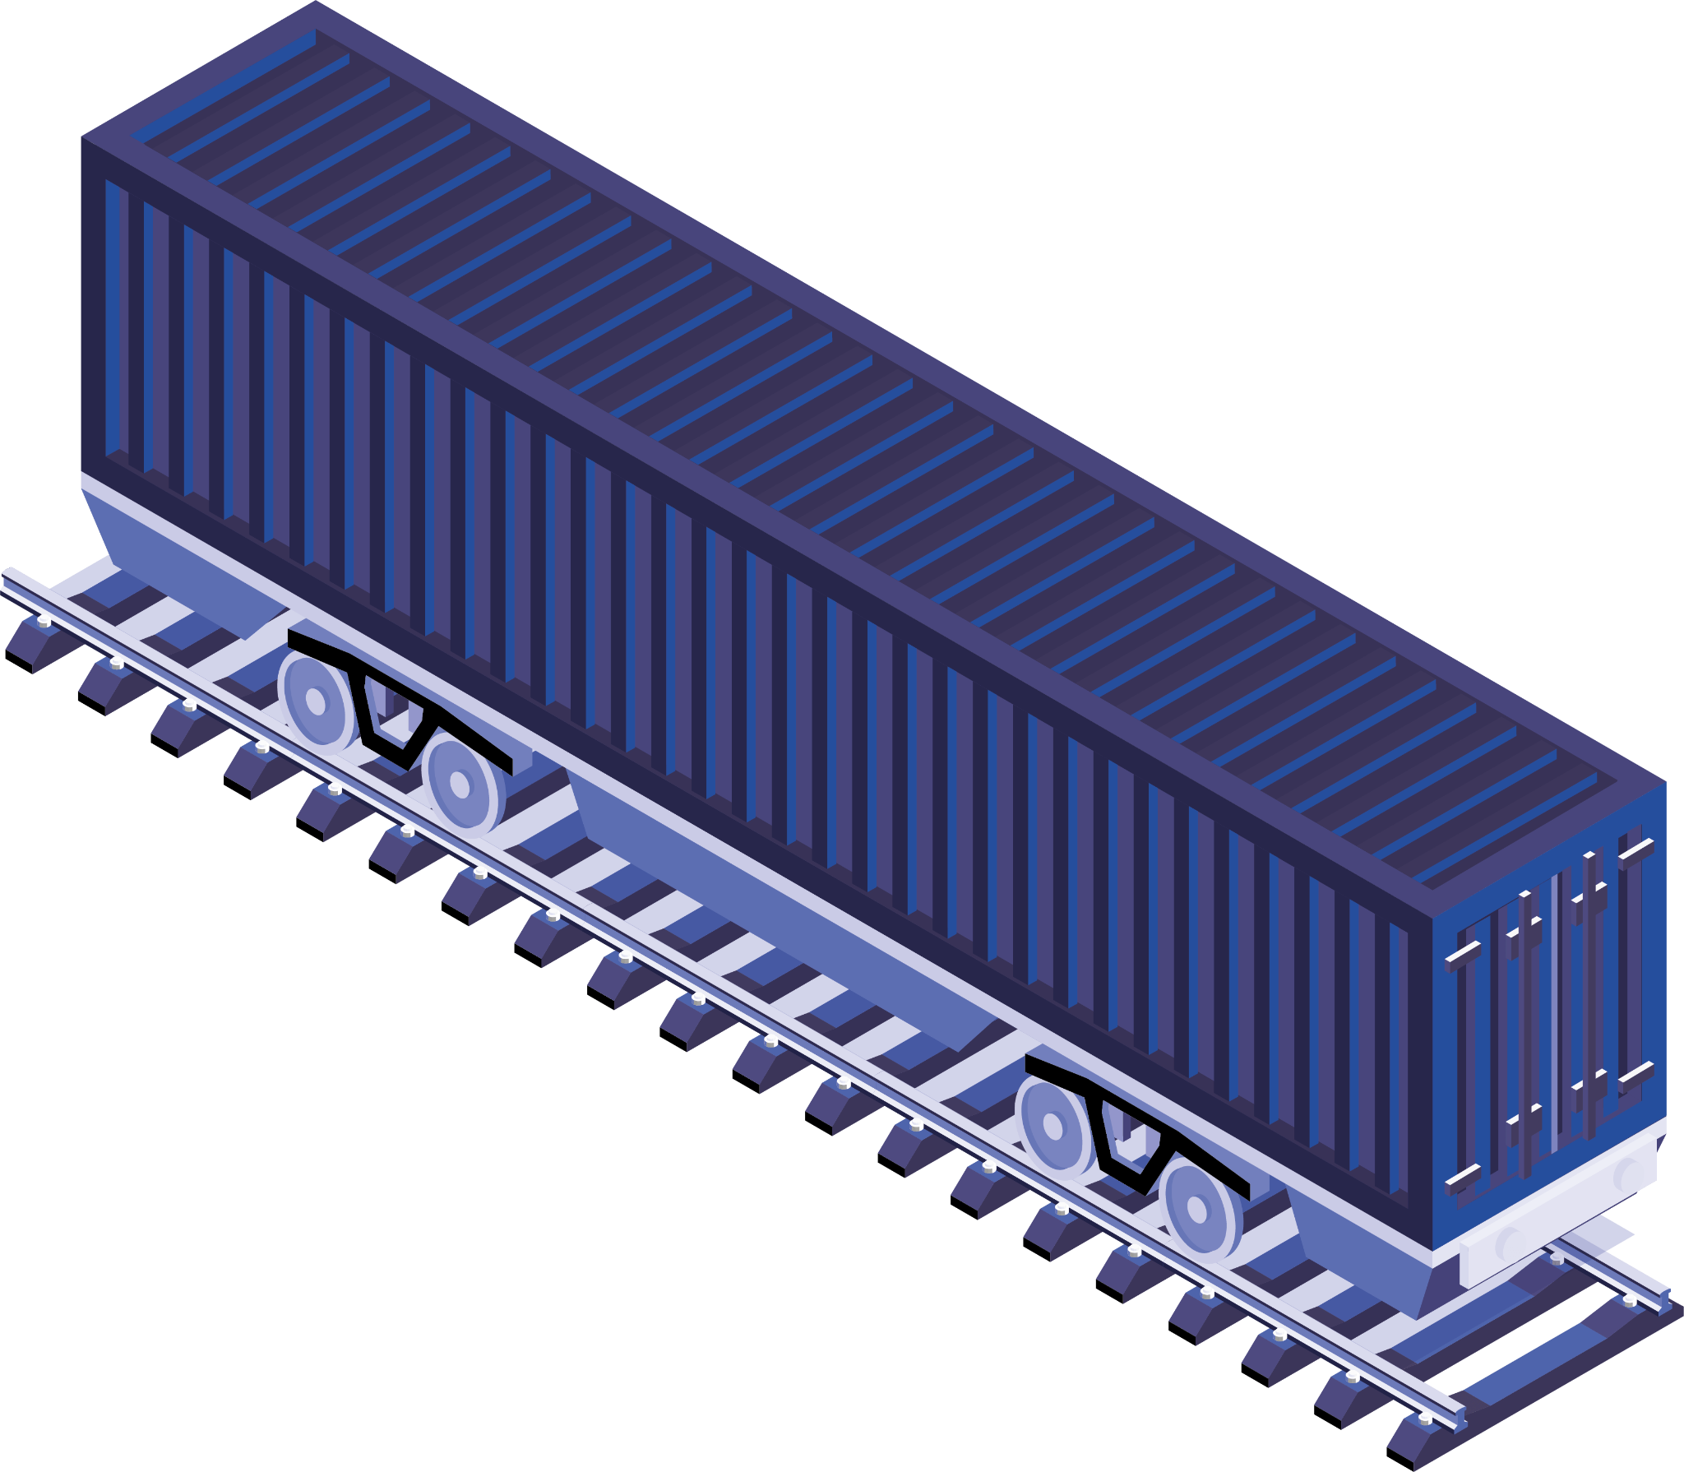


Potential Audiences
Commuters
Land Transport Authority
SMRT Corporation

Slide 8
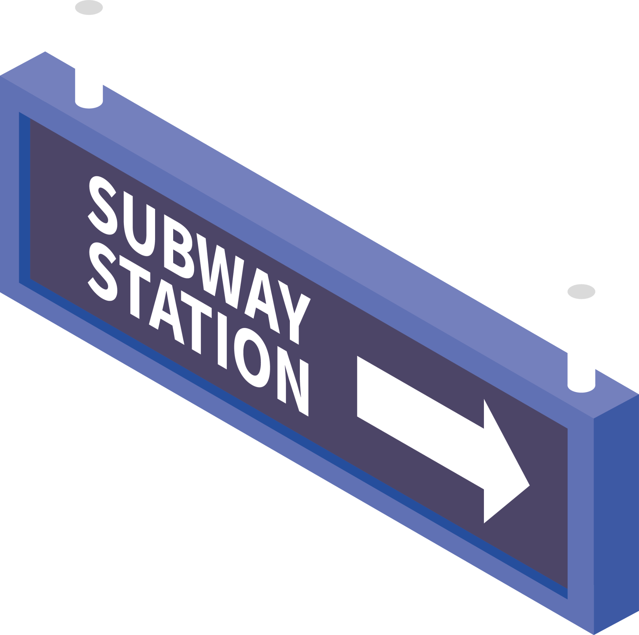
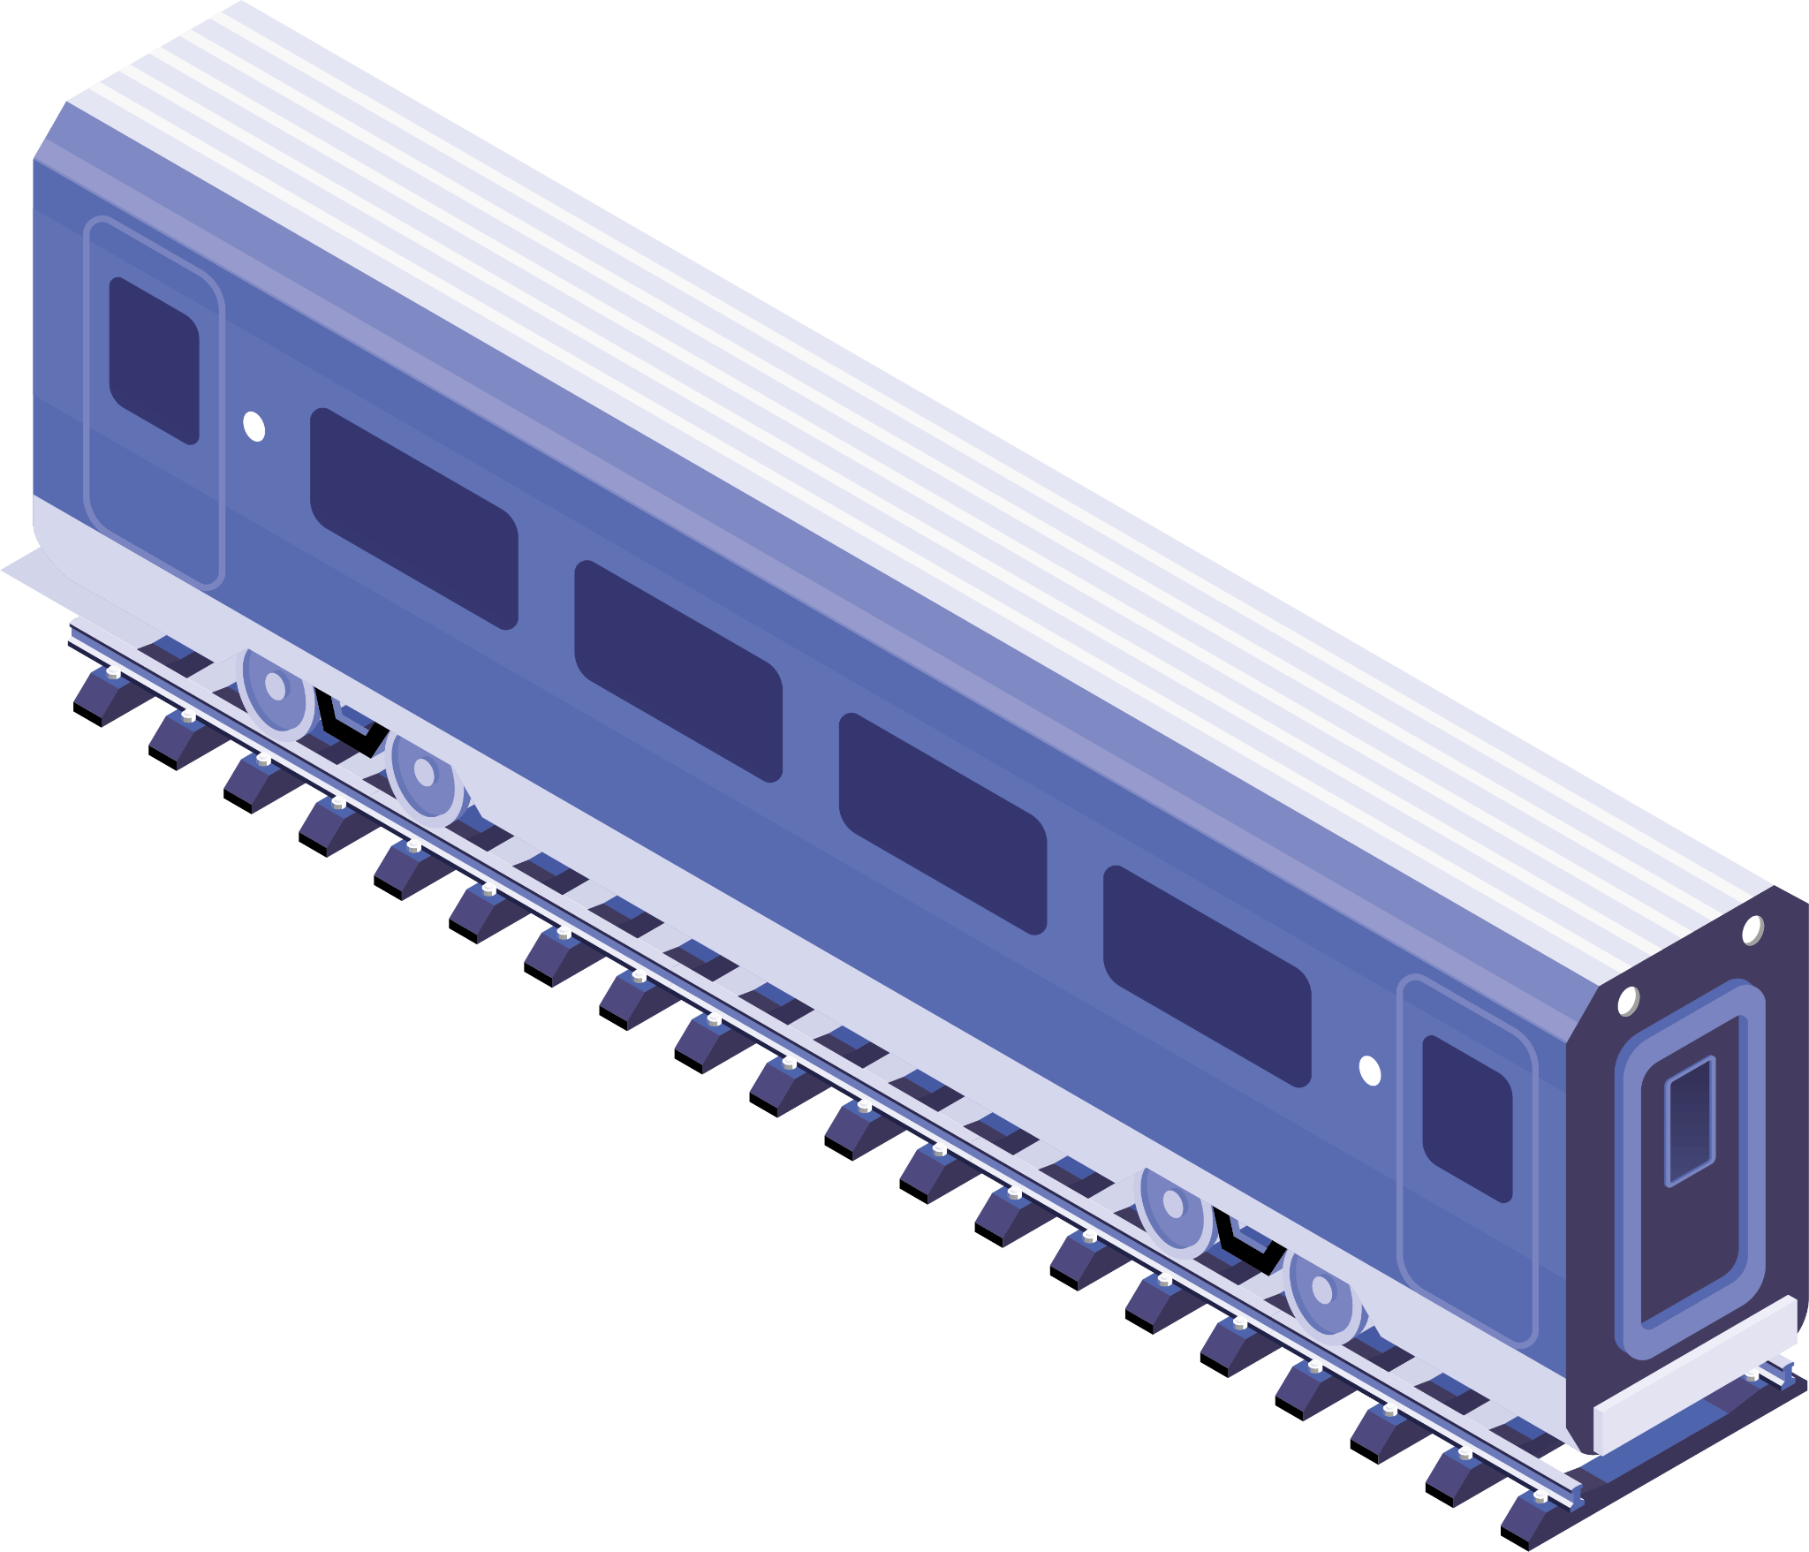
02
Datasets

Slide 9

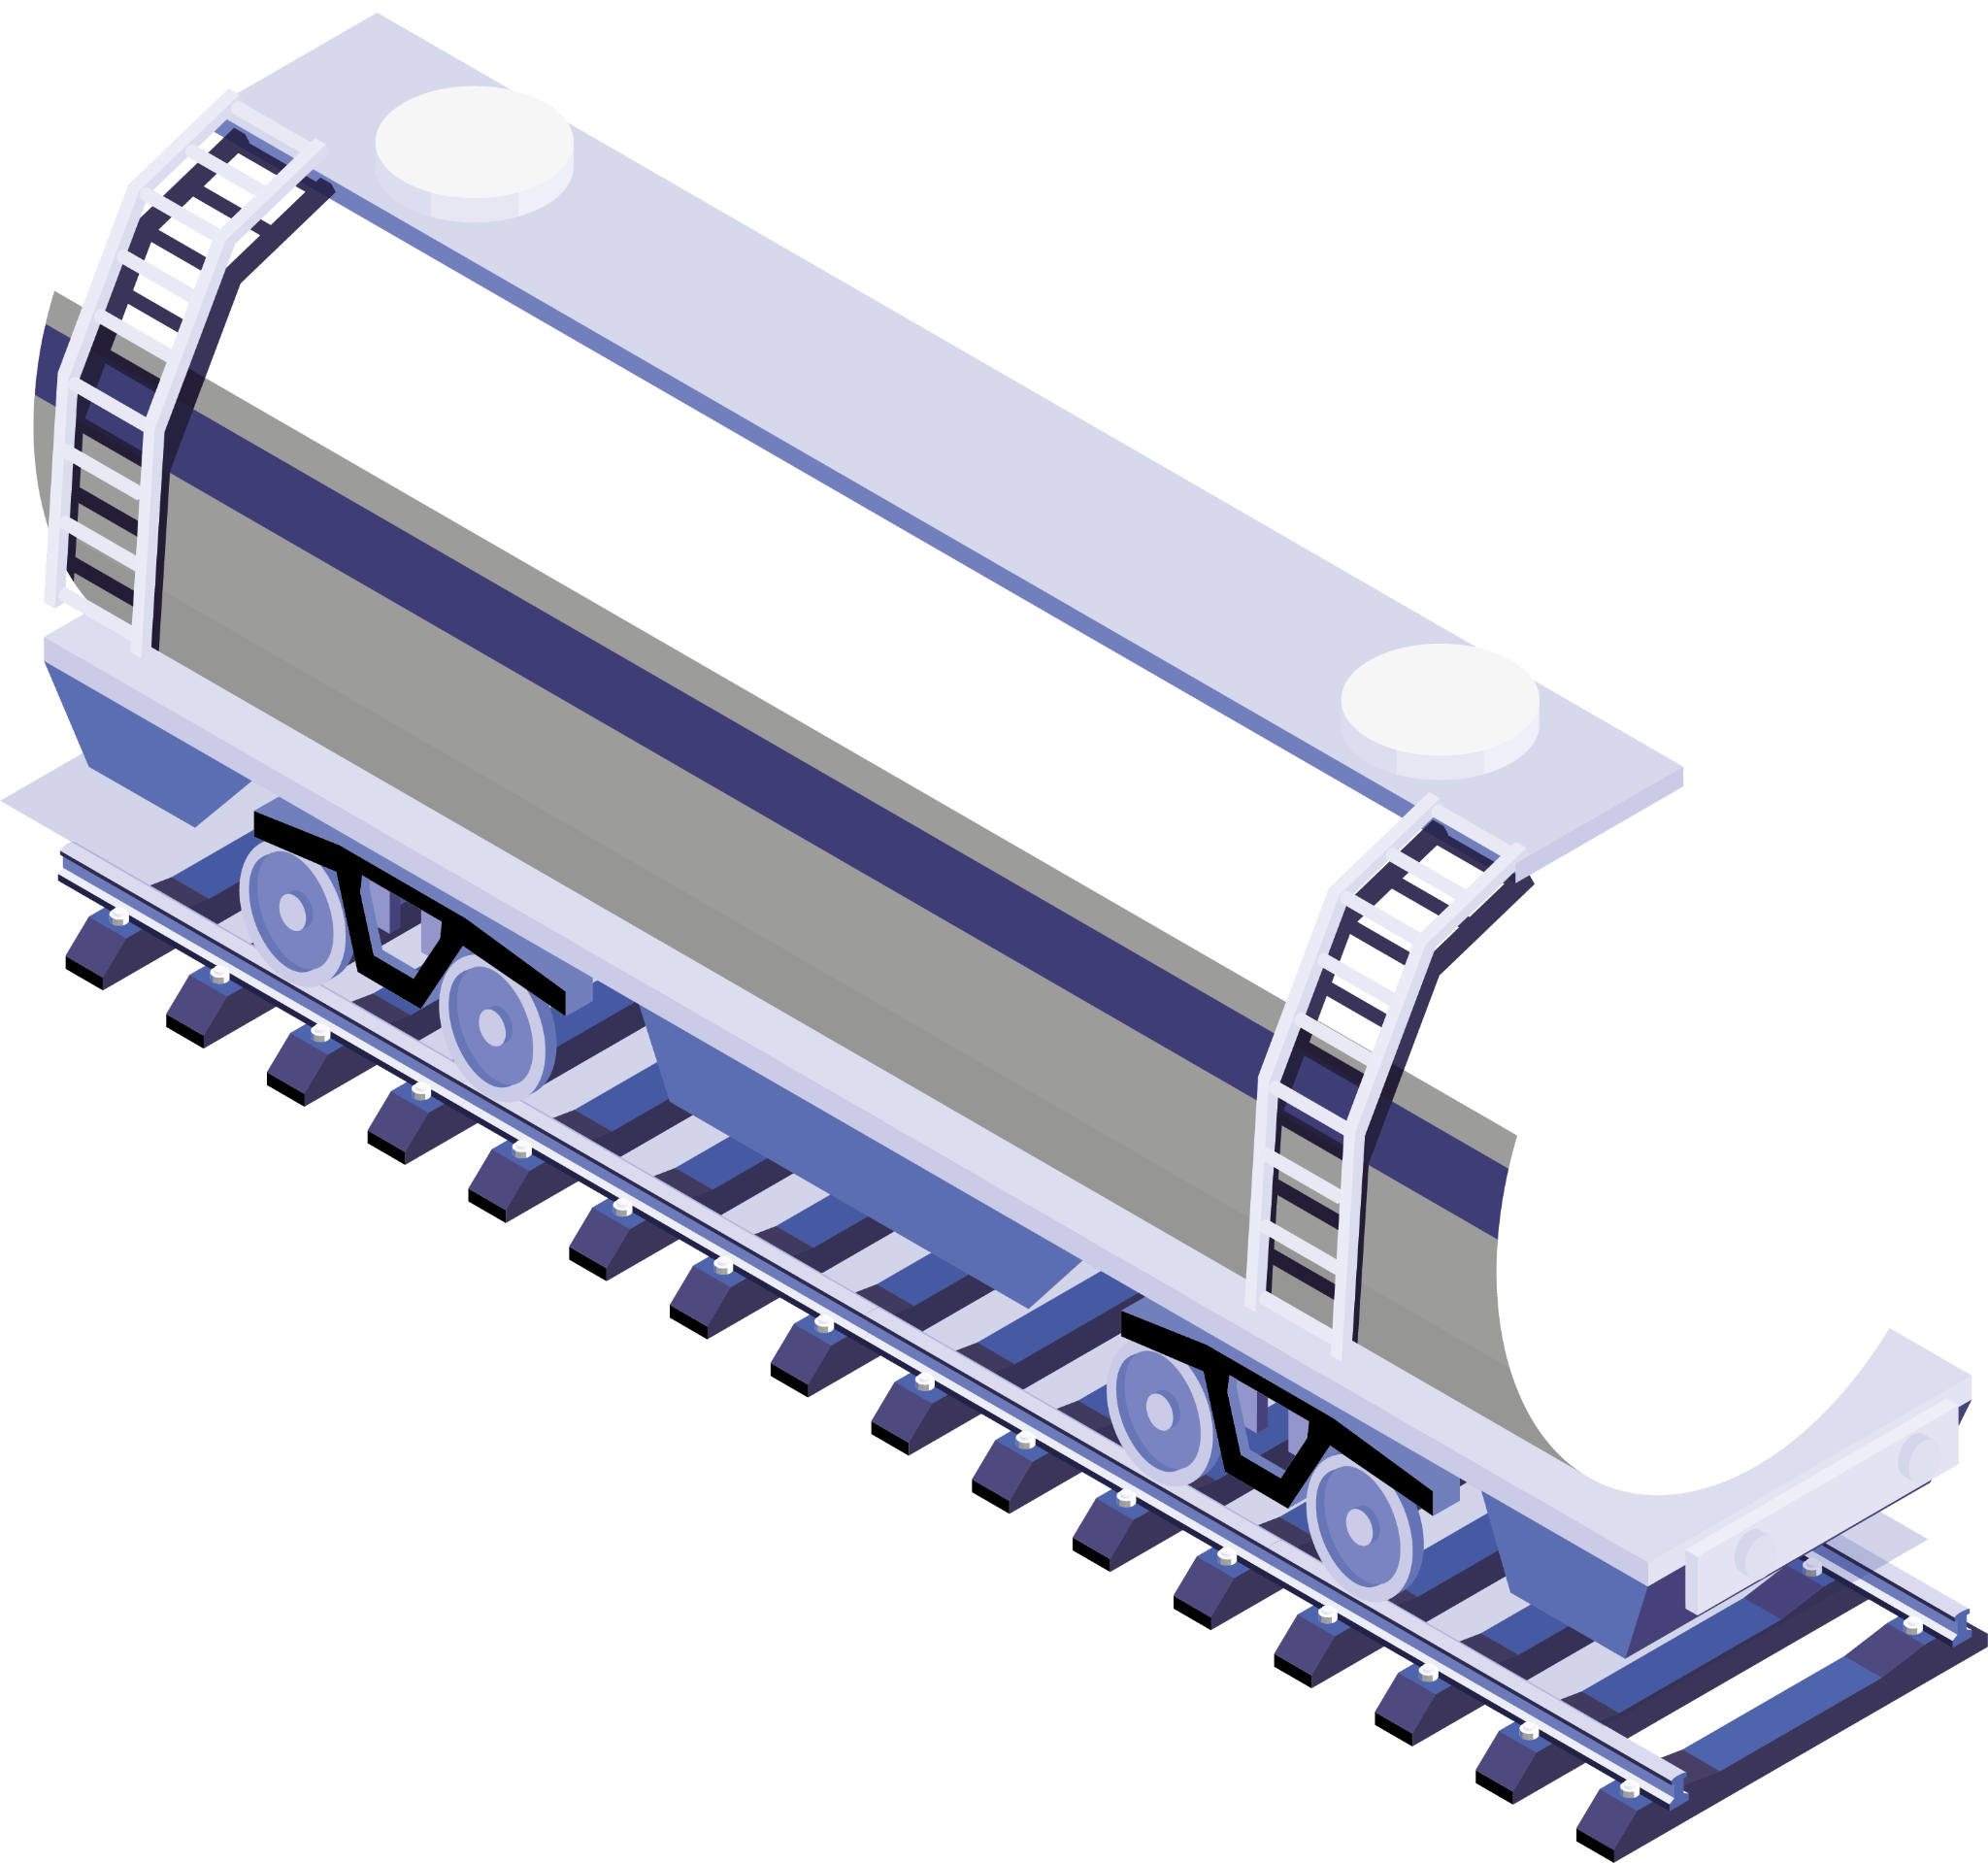
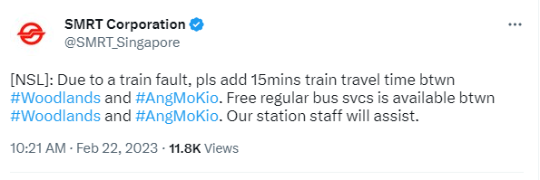

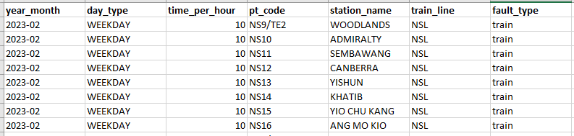
DATA COLLECTION & CLEANING
Scraped a total of 705 Tweets from 2018 to Feb 2023 (~5 years) from SMRT twitter profile
Preprocess the tweets to extract the relevant useful information
Ended with 922 lines of train faults
Notes:
Scraped from SMRT twitter profile, unfortunately, NE line, SK and Punggol LRT are not included as they are from SMRT

Slide 10

DATA COLLECTION & CLEANING
Passenger’s tap in and out data (3months) from Dec-22 to Feb-23.
Use Iterative imputer to get 5 years worth of data consist of 424,022 lines
Notes:
Iterative Imputer is a type of imputation algorithm used to fill in missing values in a dataset. It is implemented in the scikit-learn library for Python.
The iterative imputer algorithm is based on the idea of imputing missing values by predicting them from the other features in the dataset. The algorithm uses a regression model to estimate the missing values, and iteratively refits the model using the newly imputed values until convergence.

Slide 11

Modeling
03

Slide 12
Modeling
To use Supervised Classification Models to classify users’ input and predict whether the station is susceptible to delay/breakdown.

Slide 13
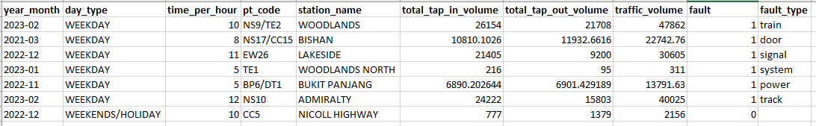
Modeling
Data prep: Combined dataset
Join on ‘year_month, ‘day_type’ and ‘station_name’.
New feature to measure traffic volume

Slide 14
Modeling
Imbalanced class
Combined dataset has 922 faults out of 424,022 lines
Used Random Under Sampler to reduce the majority class
Notes:
Excluded traffic volume because from the user perspective when using the model, they wouldn’t know the traffic volume.

Slide 15
Modeling
Features chosen
1. Time per hour
2. Day type
3. Station name
Notes:
Excluded traffic volume because from the user perspective when using the model, they wouldn’t know the traffic volume.

Slide 16
Modeling Results
Model | Train | Test | Runtime
Random Forest | 70.9% | 58.9% | 19s
Decision Tree | 68.6% | 69.3% | 0.29s
KNN | 68.8% | 65.2% | 23s
Logistic Regression | 73.8% | 72.4% | 0.53s
XG Boost | 75.6% | 77.8% | 42s

Slide 17
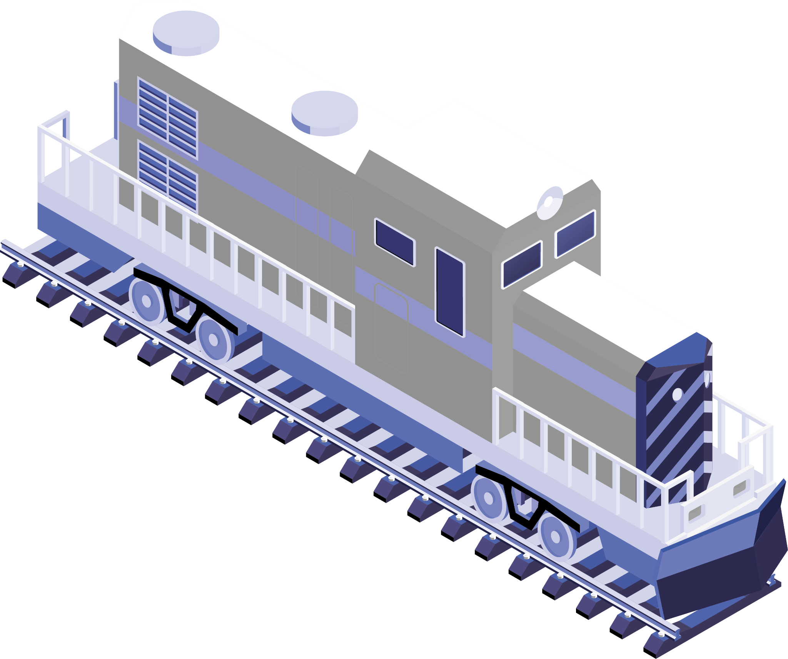
EDA / Demo
04
Let’s shift over to Tableau and Streamlit !

Slide 18
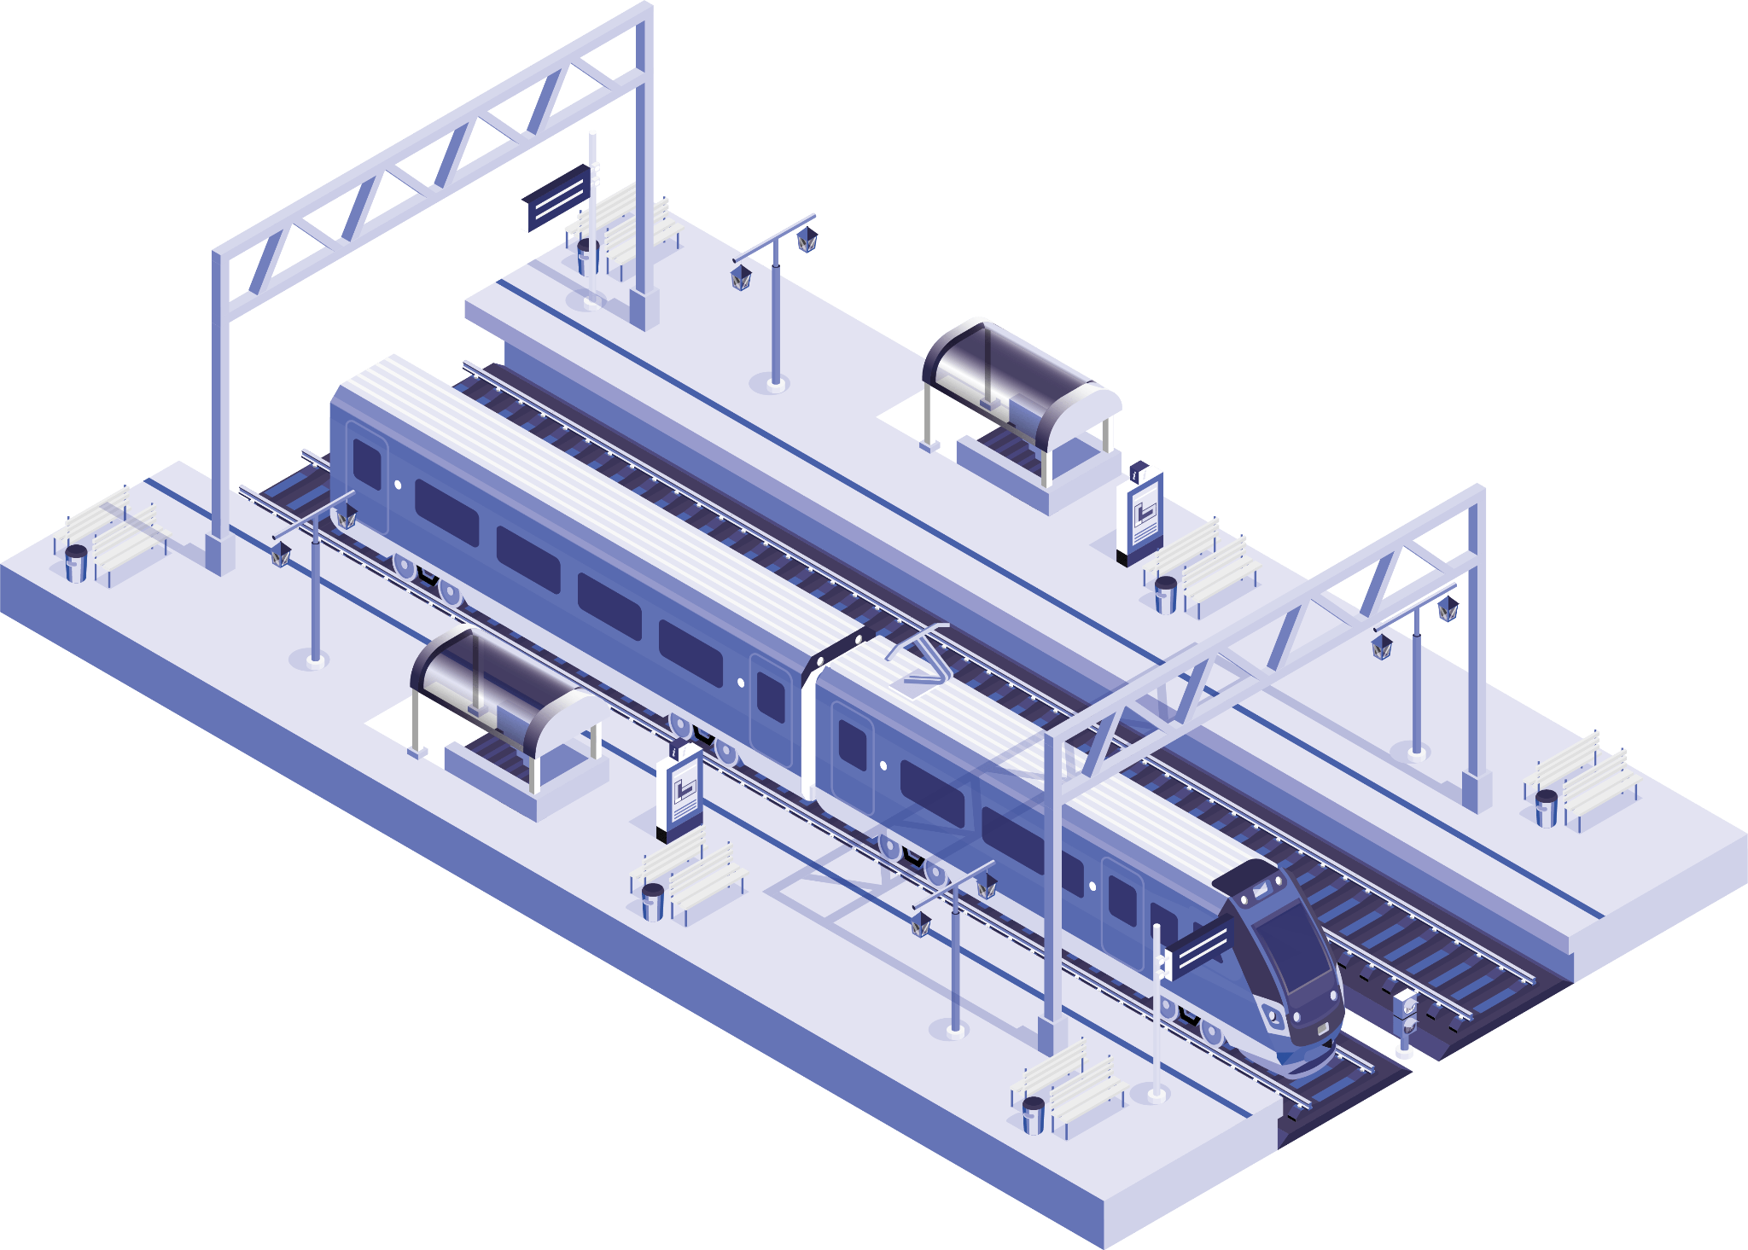
Conclusion
05

Slide 19

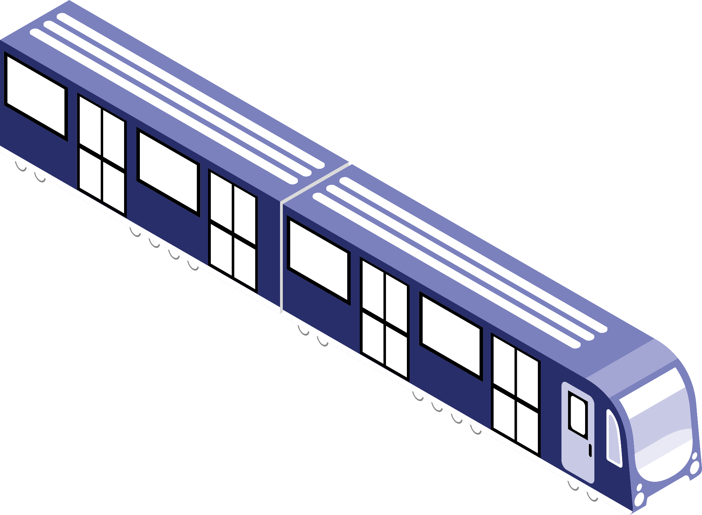
Limitations and Future improvements
Time-series
Limited data availability
Add-in new potential features
Notes:
Limited data availability due to most of the 5 years of passenger tap-in and out data being imputed and only 3 months of latest data being provided by LTA.
The predictor model only considers data from SMRT and does not include train lines from SBS transit. This can be improved in the future after scraping data from SBS transit twitter profile.
There is potential to improve accuracy and gain new insights by including additional features like weather and maintenance schedule in the predictor model.

Slide 20
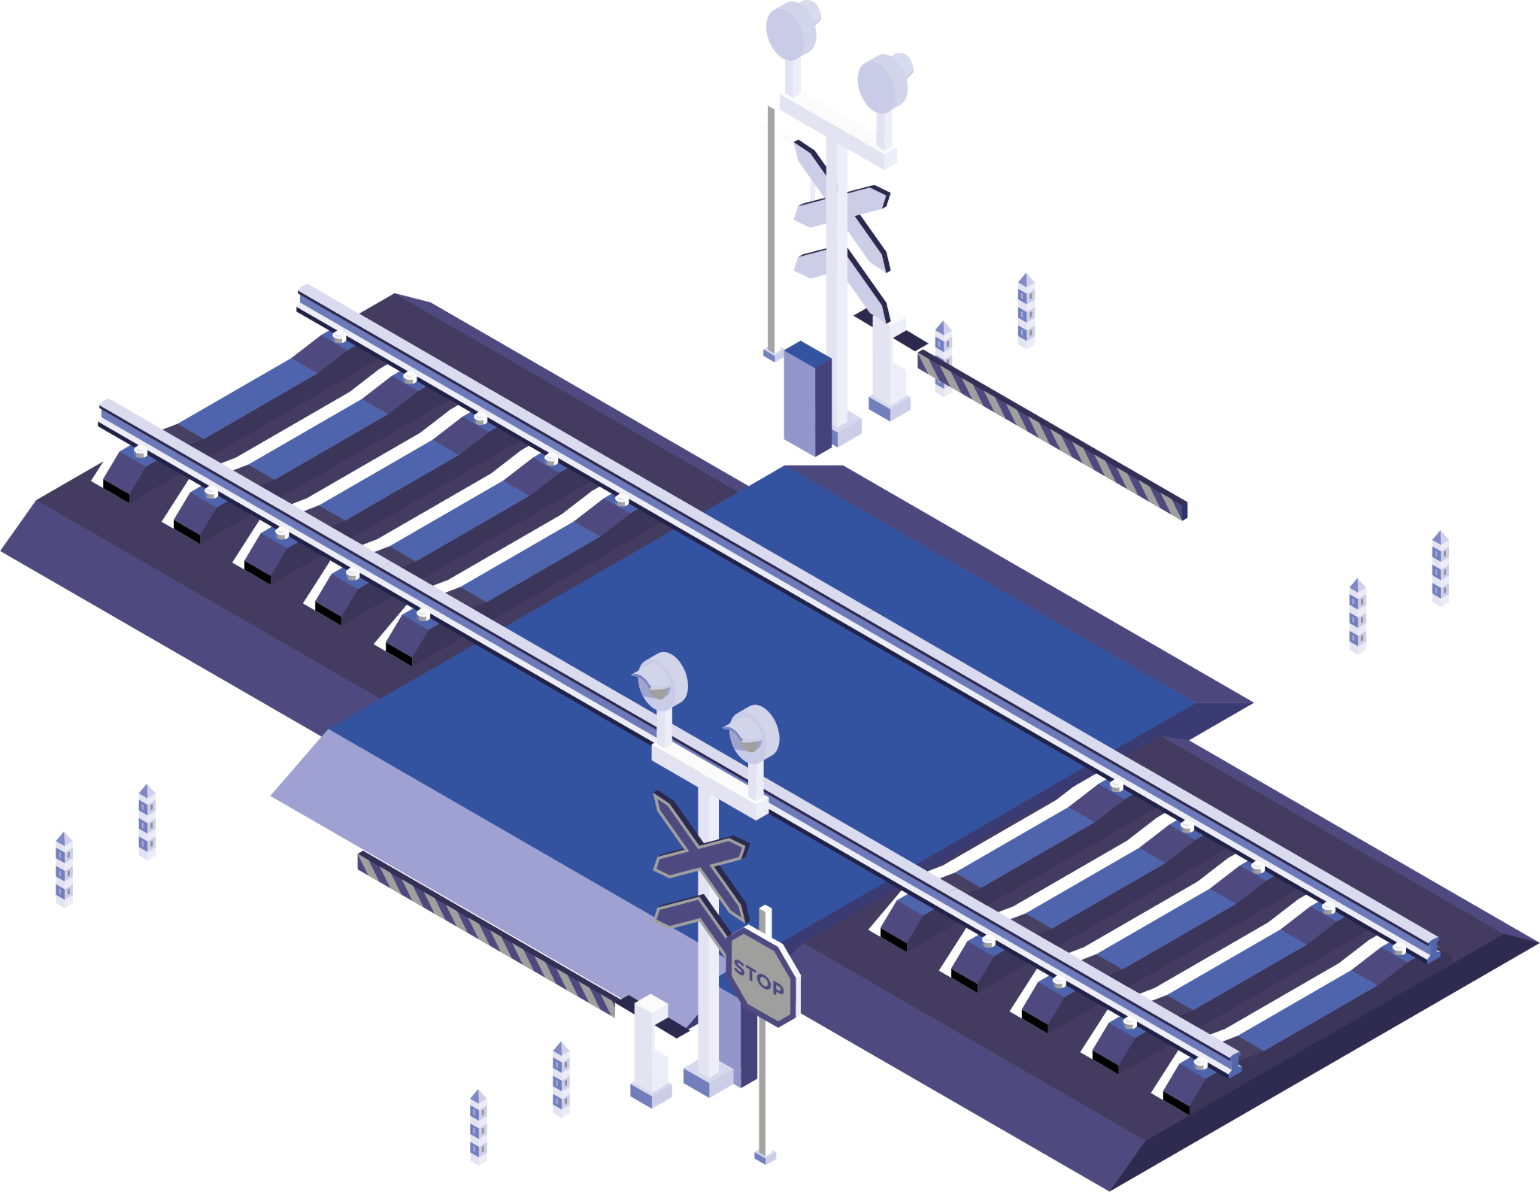
Thanks!

